Slide 1

Capstone 2: Applied Machine Learning For Daily Fantasy Hockey
Michael Wood
Springboard Data Science Capstone 2
September 2019

Slide 2
Why Daily Fantasy Hockey?
Objective: Create and deploy machine learning models to successfully predict player performance in daily fantasy hockey, an online contest where the objective is to choose the highest scoring lineup in a series of NHL contests.
Task: A constrained optimization problem, entrants have a ‘budget’ of $50,000 to spend on 8 NHL players.
Challenge: hockey as a sport is widely considered the most difficult to predict due to the level of interaction among players, difficulty isolating events, and general ‘puck luck’.¹
Value: large payouts for little risk: even the smaller contests offer value with daily NHL contests paying out up to $5,000 for a first prize for a $3 entry.²

Slide 3

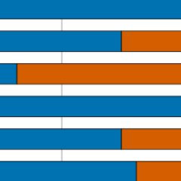
Data Collection
The data scraped from the NHL’s unofficial API, and then processed using scripts developed by the team at EvolvingHockey¹, an invaluable resource for daily results.

Slide 4
Key Terms for Features
A few essential hockey terms that will be used going forward:
Power Play: period where at least one opposing player is serving a penalty and the team has the advantage of an additional skater.
Short Handed: the inverse of the above, the situation of playing with one or more fewer player(s).
Time-On-Ice (TOI): the amount of time a player is involved in actual play. Also represented as percentage of a teams TOI, power play TOI, and short handed TOI.
Fenwick/Corsi: measurements of a players number of unblocked shots or total shots, respectively.
Points: can refer to either fantasy points or points as recorded by the NHL. In the later case points are either a goal or assist to a goal.

Slide 5
Preprocessing And Primary Feature Gathering
Data Processing: Data required modification from play-by-play to game-by-game.
Used Evolving Hockey scripts, pushed to PostgreSQL instance for storage and creation of game rank.
API scraping broken down into chunks to reduce the load on the local machine.
No NaN or missing values but some redundancies created by the chunkwise operator that were found and removed.

Slide 6
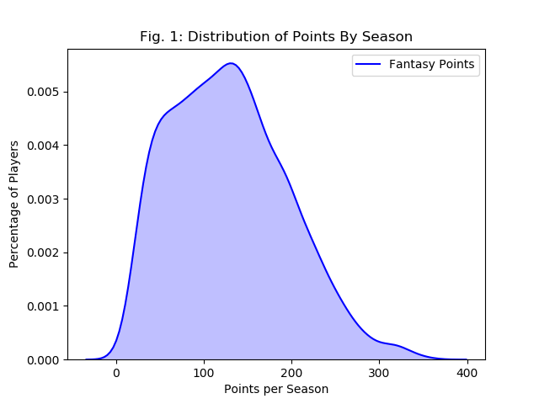
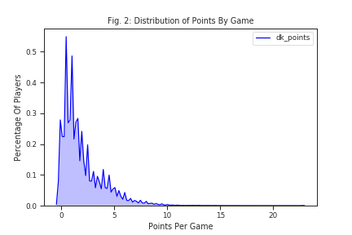
Data Exploration
Fantasy points, the primary target metric, do not have the same distribution in daily and season long contests. On a per-season basis the points are normally distributed (fig. 1) while on a per-game basis the distribution is very strongly skewed to the right (fig. 2). Gradient descent models are sensitive to the scaling of data so this is important to take into account.

Slide 7
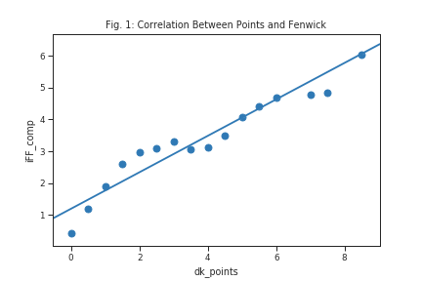
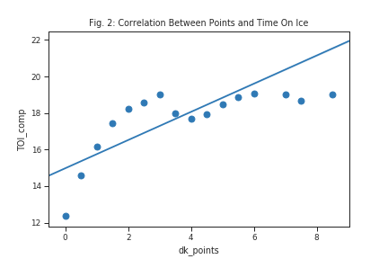
Data Exploration
Fenwick (fig. 1) remains a constant for forecasting points, does TOI (fig. 2). ¹

Slide 8
Applied Market Forecasting Theories: Moving Average Convergence Divergence
Moving Average Convergence Divergence (MACD): an idea from financial analysis, MACD is intended to act as an indicator reveal changes in direction or momentum in a stock price.
Here the intent is for the MACD to act as an indicator of changes in direction in the important values Time on Ice or Fenwick.
These features correlate strongly with overall performance, therefore an improvement in them would identify players who are undervalued as well as predict positive movement in future games.

Slide 9
Applied Market Forecasting Theories: Moving Average Convergence Divergence
MACD is created by subtracting the larger of two averages of the same number to create a signal. Shown in the formula here, x bar is the sample mean of the feature over the number of games chosen.
For example, with Time on Ice (TOI) we utilized the respective periods of the 5 and 20 previous games. If the player averaged 12 minutes of TOI over the previous five games and 10 over the previous 20, this would make the player’s MACD +2.
If the MACD is a positive value that would be considered a ‘buy’ signal, if negative it would be a ’sell’ signal.

Slide 10
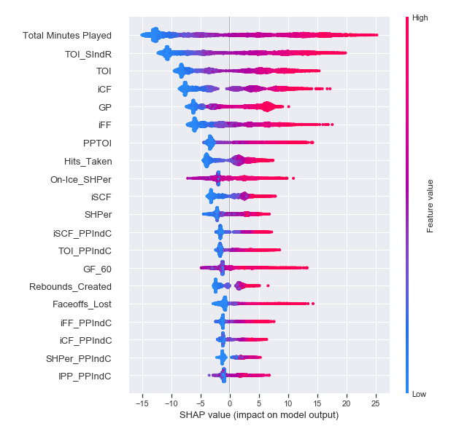
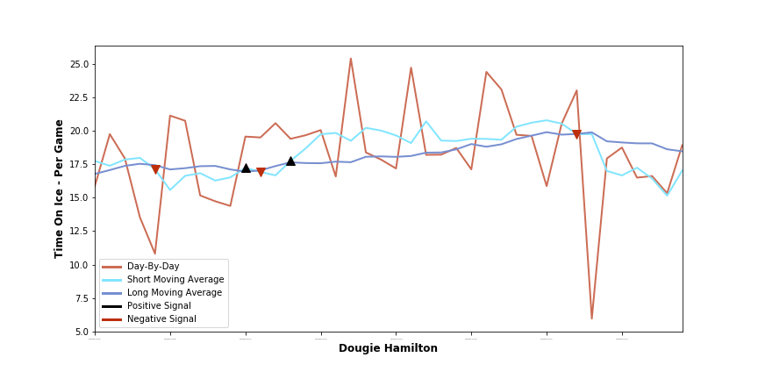
Applied Market Forecasting Theories: Moving Average Convergence
MACD for Dougie Hamilton
Signals: black arrow is positive, red negative.
Lines: Light blue is short term, dark blue is long term moving average.
The black arrow frequently proceeds a distinct upward trend in the moving averages, while the red correctly shows a negative trend.

Slide 11
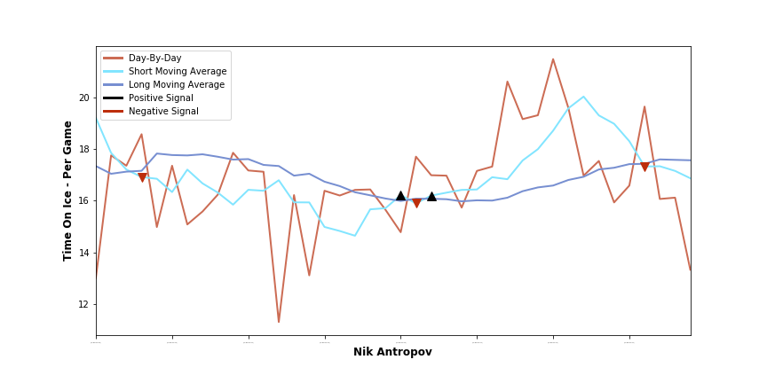
Applied Market Forecasting Theories: Moving Average Convergence
MACD for Nik Antropov
Stable player long term.
Notice how the two positive signals, as marked by the black upwards arrow in the middle of the chart, directly preceded a long term positive trend.

Slide 12
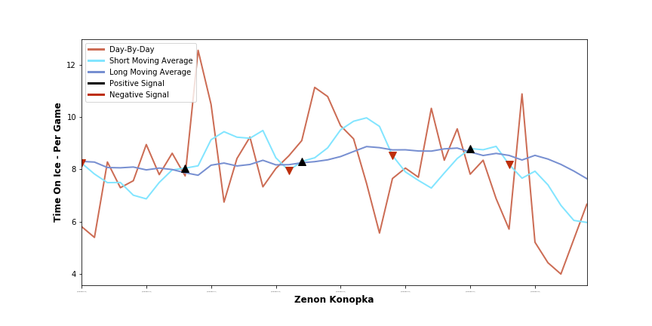
Applied Market Forecasting Theories: Moving Average Convergence
MACD for Zenon Konopka
Player with highly uneven deployment.
This uneven deployment can ‘psyche out’ the model. As seen on the left there are short term positive trends after the positive signal, but they are not maintained long term.

Slide 13
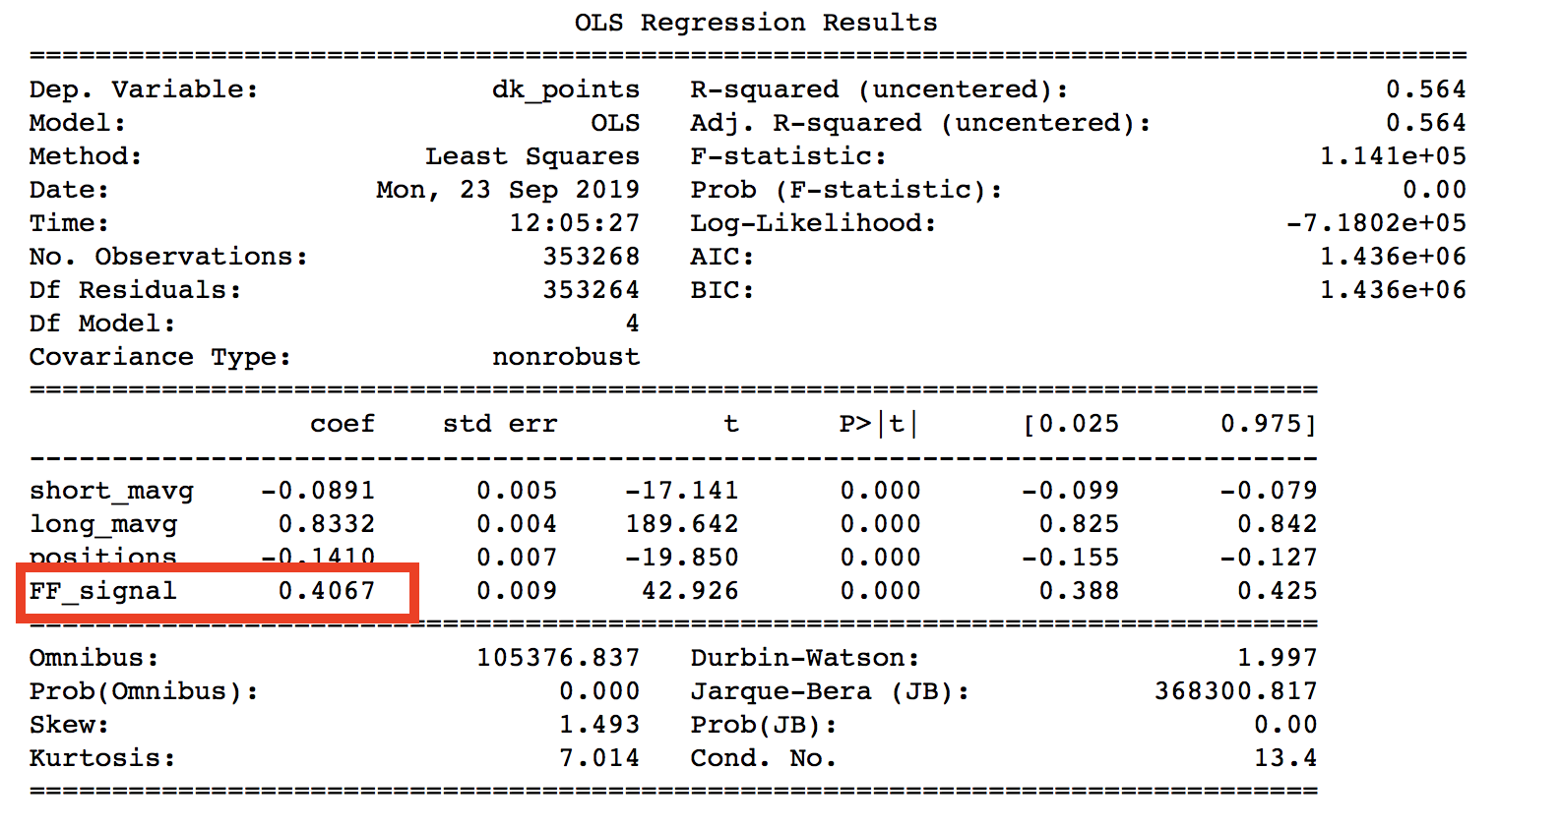
Applied Market Forecasting Theories: Analysis of Moving Average Convergence
Testing: regression analysis to measure the relationship between the signals and the target, dk_points, they were intended to predict.
Result: A positive Fenwick signal show to increase the mean value by 0.4 points, a 20% increase on average.

Slide 14
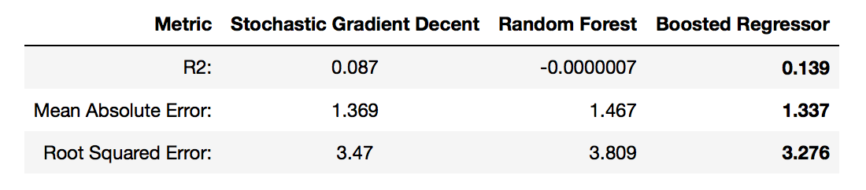
Model Building: Initial Failure
Models Deployed: Stochastic Gradient Descent, Random Forests, and Gradient Boosted Regressors.
Reasoning: Selected for their speed, accuracy, ability to deal with overfitting, and their predictive power.
Data Scaling: Data was transformed by a scikit-learn StandardScalar. This to normalizes the distribution to improve performance.
Failure: The first iteration failed in spectacular fashion. Shown here are their error rates:
R2: shows the predictive power of a model on a 0-1.00 scale. The best here, .139, is slightly better than throwing darts at a board.
MAE and RSE: predictions are off by 1.4 – 1.3 points, with average points per game is 2 points, this is almost a complete game’s worth of points.

Slide 15
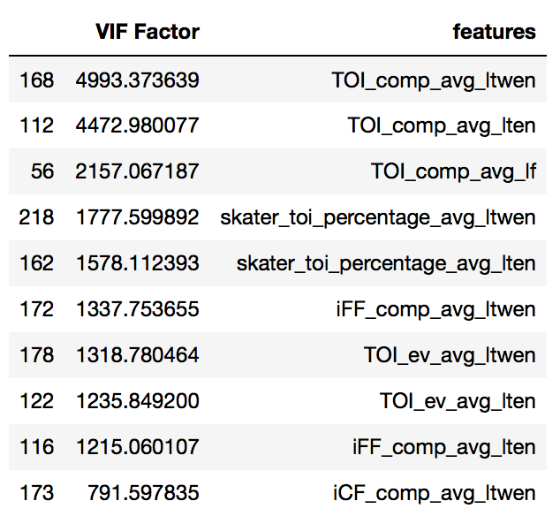
Model Building: Initial Failure
Problem One: Collinearity of data
Determined by a Variance Inflation Factor (VIF) analysis, data was confirmed to be highly correlated amongst themselves and thus multicollinear. This creates signal where there is none. This chart shows the most correlated values. A VIF score of below 5-10 is considered acceptable; of the 228 features we charted here, 7% were under 5, and 15% were below 10.

Slide 16
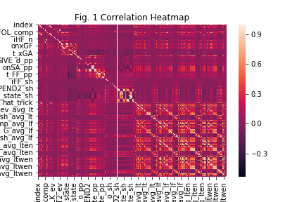
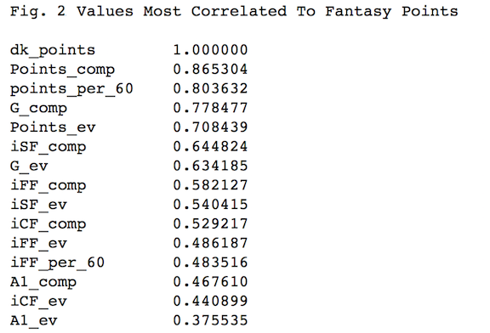
Model Building: Initial Failure
Fig 1: Correlation matrix showing the correlation of values amongst each other. Lighter values represent higher correlation.
Fig. 2: levels most correlated with points themselves. SF and FF are ’Shots For’ and “Fenwick For’.

Slide 17
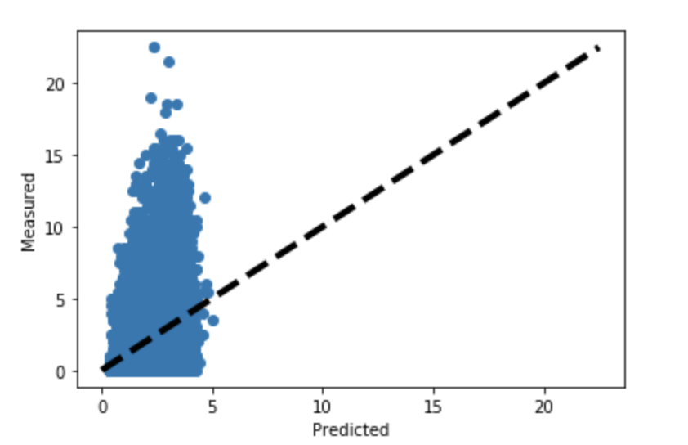
Model Building: Initial Failure
Problem Two: Realistic Projections
The chart on the left is of one of the Gradient Boosted models, with the actual outcomes on the y axis and predicted on the x axis. Note that the measured values frequently reach above 10 or 15 points while the predicted values are locked between 0-5 points.

Slide 18
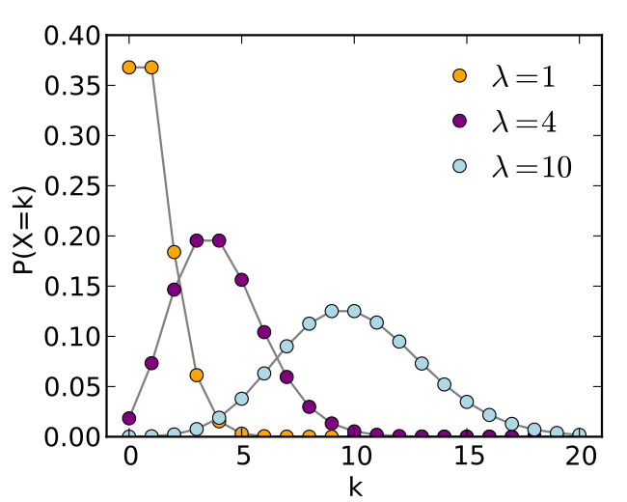
Model Building: Moderate Success
Pivoted to a Poisson Regression Model: This works better on Discrete Probability events, situations where the “probability of a given number of events occurring in a fixed interval of time … examples that may follow a Poisson distribution include the number of phone calls received by a call center per hour”^{1.}
Example chart from Wikimedia
Besides our dk_point distribution.

Slide 19
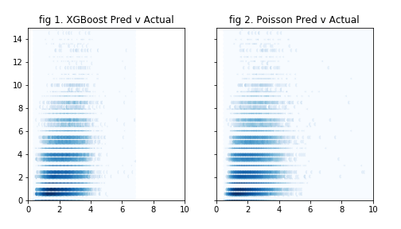
Model Building: Moderate Success
Improvement: the projected values were more in line with expectations. The mean value was still about 2 points, but the standard deviation was 0.75 instead of 0.6. Note the plotting here as opposed to the boosted regressor shown before.

Slide 20
Application: Goals and Tools
Test: How does this perform in actual contests?
Challenges: companies do not publish contest results, and live testing was not possible.
Simulation: utilized FantasyCruncher, a tool to optimize lineups and a database with historical results.
Three historical dates chosen at random.
The model was imported for those dates, and lineups were created.
Considered successful if the lineup exceeded 35 points in one of these simulations, the typical minimum value place in the money.

Slide 21
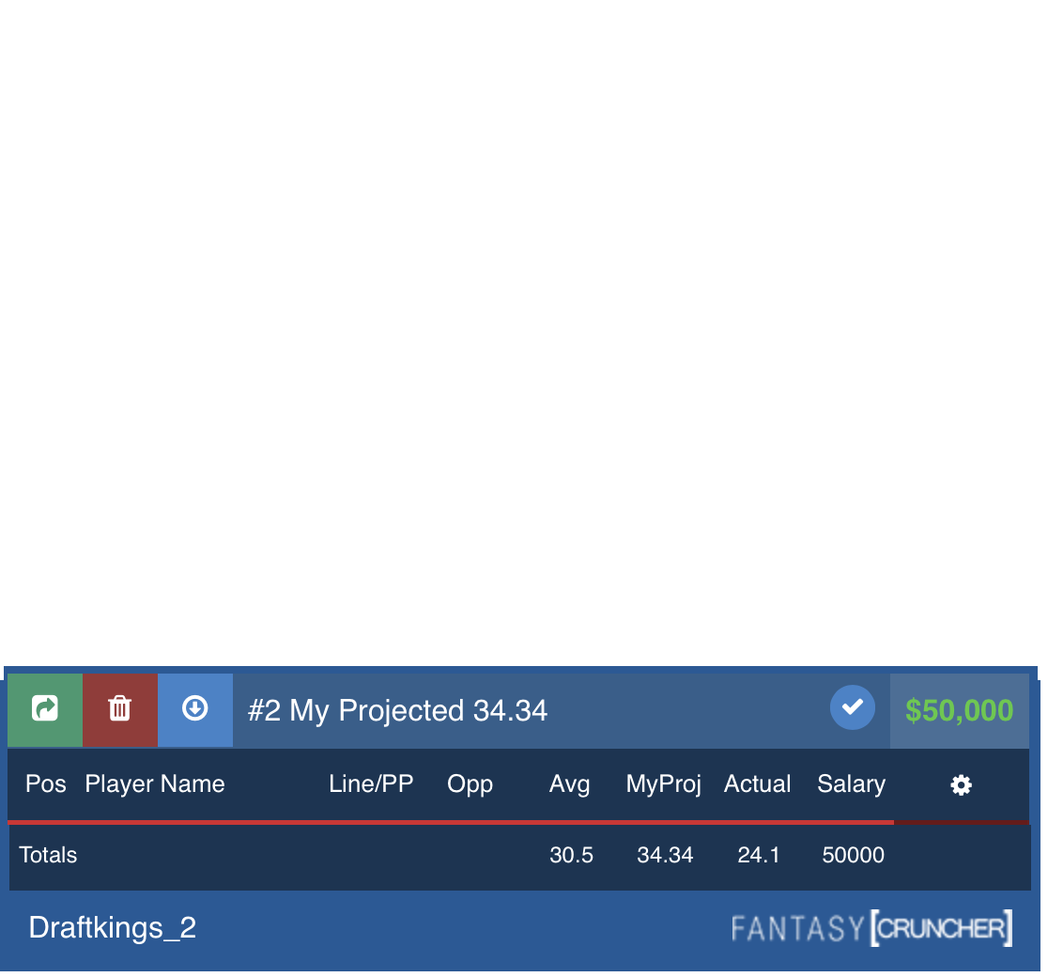
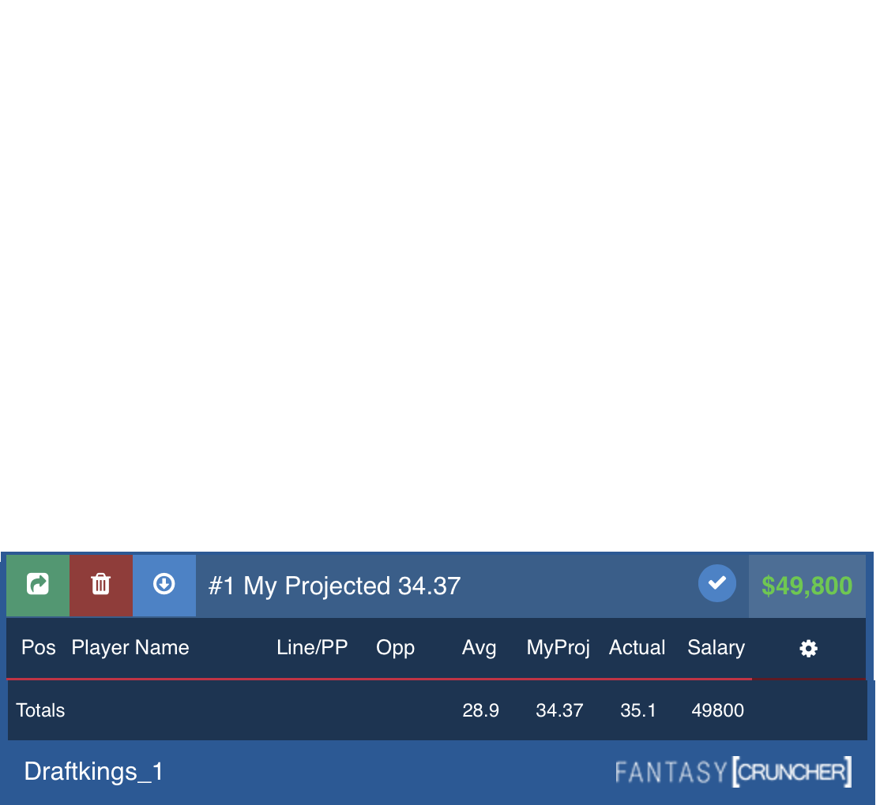
Naïve Application
Without human input: the model did not out-perform the off-the-shelf projections Below is a comparison of the naïve lineups (upper) and FantasyCruncher (lower).
Notes:
Again, the typical lower bound for cashing in in a contest is 35 points so given that target the FantasyCruncher lineup would have succeeded while the naïve model would not.

Slide 22
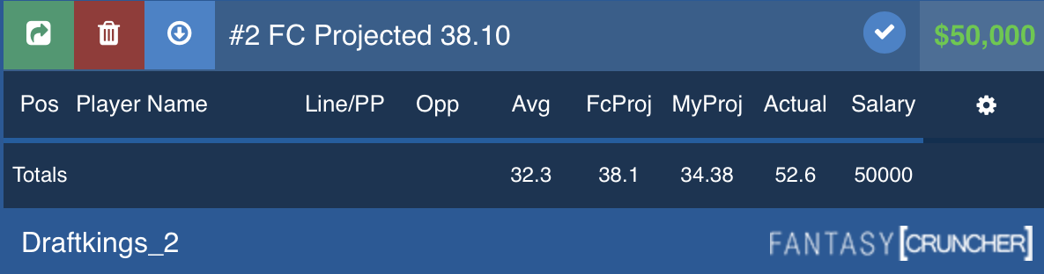
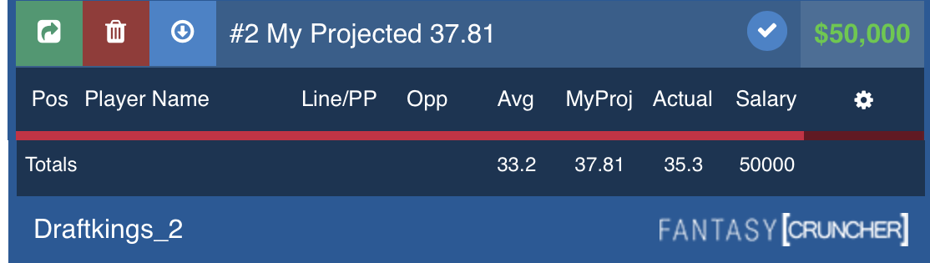
Non-Naïve Application
Minimal Human Supervision: successful result for the models.
FantasyCruncher was limited to two options in the goalie position, selected for being the starting goalie for the team most favored to win by Las Vegas Casinos. The Non-Naïve model (left) would have done significantly better than FantasyCruncher alone (right).

Slide 23
Extensions
Further apply Las Vegas odds: use the Vegas lines as direct inputs to utilize their research.
Strength of opponent metrics; marry the trends of the opposing teams to the basic stats. For example, create a signal for opposing teams showing increased defensive capacity which would limit player goals.
Poisson model: with revised features, or with sub-groups of players.
increase the points spread in the target variable: a more naturally occurring normal distribution might also increase accuracy in predictions.

Slide 24
Conclusions
Minimal human supervision: makes this a viable model, but not predictive enough without it.
Main challenges: in finding features that aren’t multicollinear and in selecting model that worked for the distribution of target values.
MACD: has promise, and perhaps an even simpler model based on those with core features might increase performance.

Slide 25
Acknowledgements
There were many reviewers who added edits and helped greatly improve this presentation. Thanks to Marcia Burchby, Dayna Clark, Jimena Gargiulo, Megan Ogle and George Wood, among others.
But I’d primarily like to thank both my mentor for this course, Alex Rutherford, and my mentor throughout my data science career, Michael Burton, for helping along the way to guide my progress, point out areas of improvement, and generally being great sounding boards. This project would be much less successful without them.

